Slide 1

Container Networking Powered by
Jianfeng Tan, Cunming Liang, Heqing Zhu, Huawei Xie

Slide 2
Agenda
Background
DPDK-powered techniques
Using SR-IOV + DPDK in Containers
Connect containers with user space vswitch
User space network stack
DPDK-powered VNFs

Slide 3
Container networking status quo
Multi-host networking
Container
Network Virtualization
Service
Container
Network Virtualization
Service
Linux Kernel
Linux Kernel
Agent

Slide 4
But not ready for scenarios like…
Container-based VNFs
High-throughput networking functions like
LB, FW, IDS/IPS, DPI, VPN, pktgen, Proxy, AppFilter
Latency-sensitive and jitter-avoid applications
Game applications
E-commerce flash sales
Stock exchange trading
Video conference
Real time network app

Slide 5
Challenges of high perf. network
FWD 1~2 Mpps per core
NIC | Time budget for 64B | Time budget for 1518B
10Gb | 67.2 ns | 1,230 ns
40Gb | N/A | 307 ns
100Gb | N/A | 120 ns
NIC | Time budget
System call | 75 ns/42 ns
Atomic ops | 8.25 ns
Spinlock lock/unlock | 16+ ns
L3 miss | ~80 ns
Data from LWN article, 3GHz CPU

Slide 6
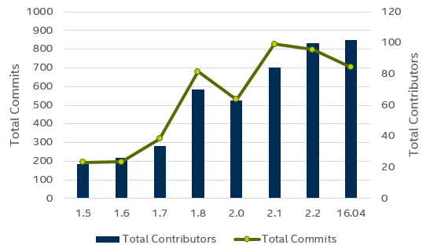





















Open Source Software
The Data Plane Development Kit (DPDK) is a set of software libraries for accelerating packet processing workloads on COTS hardware platforms.
Customer Adoption

Slide 7
How do we solve it in BM - DPDK
CPU affinity
Hugepages
UIO
Polling
Lockless
Batching
SSE/AVX
High-throughput
Low-latency
Deterministic

Slide 8
Can we leverage DPDK to accelerate Container Networking?

Slide 9

VM vs Container
SR-IOV
VIRTIO
A
B
App0
Appn
App0
App1
…
Appn
App1
…
vSwitch
VM
HOST
HOST
C
C0
C1
…
Cn
D
C0
C1
…
Cn
vSwitch
Container
HOST
HOST

Slide 10

Using SR-IOV + DPDK in Container
Requires: device mapping (vfio)
High-performance: small pkts line rate with 10 GbE
but
# of VFs is limited (64 or 128)
Not flexible (by HW)
Container
Linux Kernel

Slide 11
VM vs Container
SR-IOV
VIRTIO
A
B
App0
Appn
App0
App1
…
Appn
App1
…
vSwitch
VM
HOST
HOST
C
C0
C1
…
Cn
D
C0
C1
…
Cn
vSwitch
Container
HOST
HOST

Slide 12


Connect containers with user space vswitch
Container/App
vSwitch
DPDK
Virtio PMD
Device Emulation
virtio
vhost
vhost-user adapter
Socket
/tmp/xx.socket

Slide 13
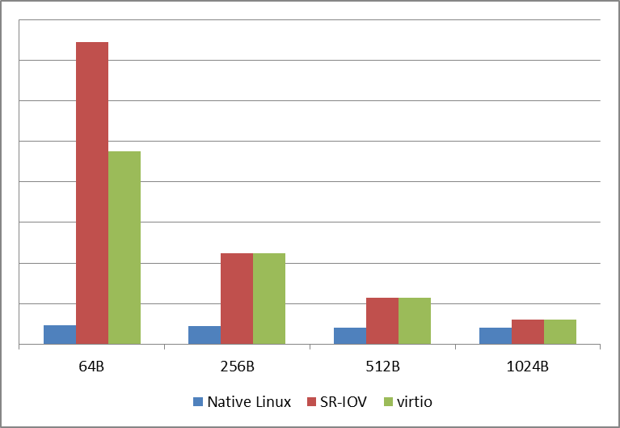
Performance Evaluation - throughput
pcap lib
ixgbe kernel
NIC
Container
Instance
ixgbe PMD
NIC
Container
Instance
virtio
PMD
vhost PMD
ixgbe PMD
NIC

Slide 14
Performance Evaluation - latency
pcap lib
For native Linux, ms level
For the other two, us level
ixgbe kernel
NIC
Container
Instance
ixgbe PMD
NIC
Container
Instance
virtio
PMD
vhost PMD
ixgbe PMD
NIC

Slide 15
More about determinacy
Deterministic CPU env
Disable timer / task scheduler
Core-thread affinity
Deterministic cache/memory env
Data Direct I/O (DDIO) technology
Cache Allocation Technology (CAT)
Software prefetch

Slide 16
Agenda
Background
DPDK-powered techniques
Using SR-IOV + DPDK in Containers
Connect containers with user space vswitch
User space network stack
DPDK-powered VNFs

Slide 17
User space network stack
Type I: DPI, FW …
Type II: Applications in need of TCP/UDP stack
Type I App
Type II App
TCP/UDP
ICMP
DHCP
ARP
Driver
Interfaces

Slide 18
User space network stack
TCP/UDP stacks
From scratch: mTCP, LwIP, Light
Ported: libuinet, NUSE (libos), Linux Kernel Library
To choose a open source stack, consider
Integration effort
Performance
Compatibility

Slide 19
Agenda
Background
DPDK-powered techniques
Using SR-IOV + DPDK in Containers
Connect containers with user space vswitch
DPDK-powered vSwitch
Virtio for container
User space networking
DPDK-powered VNFs

Slide 20

Transform middleboxes with DPDK-powered VNFs
C
C
C
C
vSwitch
vSwitch
Container Host
Container Host
Container Host
Logic Network 0
Logic Network 1
Middleboxes
Gateway
VNF
Middleboxes
VNF
Middleboxes
VNF
Powered by DPDK

Slide 21
Vortex from Ucloud
Application
Scale-up L4 LB
PPS: 14M (64B line rates)
CPS: 200K+
CC: 30M+
Hardware
CPU: Xeon E5-2670v2 (10 core 2.5G) * 2
NIC: 82599ES 10GbE
LKL
hijack by LD_PRELOAD
System Call
Socket Callback
Socket
TCP/IP Stack
DPDK netdev
ul arch

Slide 22
pkt-gen - TRex
Features
L4-7 traffic
Latency/Jitter measurements
Flow ordering checks
NAT, PAT dynamic translation learning
Cross flow support (e.g RTSP/SIP) using plugins
Performance
200Gb/sec with one Cisco UCS (Intel XL710)

Slide 23
Other promising workloads
Webserver: nginx
In-memory DB: redis
Memory cashing system: memcached
Distributed FS: Ceph
……

Slide 24
Summary
Use DPDK to power container networking
SR-IOV (existing)
Virtio (will be available in DPDK 16.07)
Compared to traditional ways, we provide a way to achieve
High throughput
Low latency
Deterministic networking

